Slide 1

Pearl Strategy & Innovation Design
Online Innovation Idea Generation

Slide 2



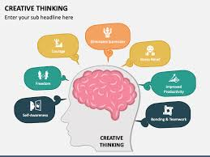

Business Understanding
Deeper Insights
Activation of Creative Thinking
Internal Review of Ideas and Capabilities
We invest the time to understand your market, and business to solve your innovation goals with growth in mind. We leverage your current internal data to set up the context for the project.
We dig deeper for consumer & human insights as foundational building blocks to a resonant relationship between your brand & consumer. This would include qualitative research. This would also include conducting a trends analysis category and other Related Worlds prior to any research.
We create an online group of creative professionals across the world, in all walks of life, to create innovation ideas. They work through the creative process with your goals in mind.
We with your team evaluate the ideas to ensure they meet your business and innovation strategy, goals, and your internal capabilities and resourcing requirements.

Slide 3

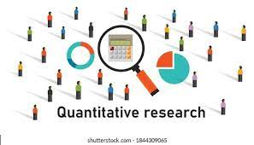
Size of the Prize
We provide quantitative research solutions to evaluate concept appeal and business evaluation of revenue generation to drive your growth goals.

Slide 4
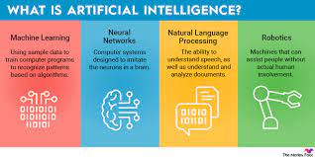
Innovation solutions – AI
AI , Artificial intelligence is the science of making machines that can think like humans. It can do things that are considered "smart." AI technology can process large amounts of data in ways, unlike humans. The goal for AI is to be able to do things such as recognize patterns, make decisions, and judge like humans
Data and analytics, technology powered
AI delivers insights faster, for less money, but requires human insights from hands on experience from insight professionals
We have a range of vendors who can deliver AI options if this is a better option for you to meet your innovation goals

Slide 5
Innovation Credentials
Proven corporate experience at Kellogg’s, leading successful innovation launches and part of the Global Innovation team at Kellogg’s
Proven success at Pearl launching innovation in market
Trained moderators at the RIVA school in the U.S., considered the best qualitative training program
Rotman Business Design training from the University of Toronto, Roger Martin led program
CPSI Creativity training from the University of Buffalo

